Slide 1
Analysis of
Global Technological Development
MTH516 Project
Group-16
Siddharth Pathak 211034
Pankajh Jhamtani 210695
Om Shivam Verma 210684
Supervisor: Prof. Sharmishtha Mitra

Slide 2
Data & Data collection
Data Source: World Bank
Parameters used : -
- High Technology Exports
- Patent Applications
- R&D Expenditure (% of GDP)

Slide 3
Data & Data collection
Data Source: World Bank
Parameters used : -
- High Technology Exports
High-technology exports are products with high R&D intensity, such as aerospace, computers, pharmaceuticals, scientific instruments, and electrical machinery.

Slide 4
Data & Data collection
Data Source: World Bank
Parameters used : -
- High Technology Exports
- Patent Applications
Patent applications are worldwide patent applications filed through the Patent Cooperation Treaty procedure or with a national patent office.

Slide 5
Data & Data collection
Data Source: World Bank
Parameters used : -
- High Technology Exports
- Patent Applications
- R&D Expenditure (% of GDP)
Gross domestic expenditures on research and development (R&D), expressed as a percent of GDP. They include both capital and current expenditures in the four main sectors: Business enterprise, Government, Higher education and Private non-profit. R&D covers basic research, applied research, and experimental development.

Slide 6
Data cleaning & Preprocessing
NA values

Slide 7
Data cleaning & Preprocessing
NA values
Removed rows and columns with more than 50% missing data
Used na.approx to interpolate some of the remaining NA values for each time series

Slide 8
Data cleaning & Preprocessing
NA values
Common Countries
Selected only the countries that had some data available for all 3 indicators
Total 73 Countries found after intersection

Slide 9
Data cleaning & Preprocessing
NA values
Common Countries
Final data
High Technology Export - 73 countries * 15 years
Patent Applications - 73 countries * 42 years
R&D Export - 73 countries * 26 years

Slide 10
One-sample Methods

Slide 11
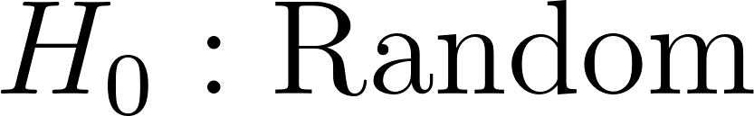
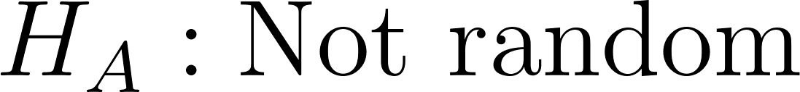
Run Test
Objective:
Analysing stagnancy over the period of 2008-2021 for multiple countries for parameters.
Comparison of developed and developing countries.
Methodology (applied to each country for each parameter):
Two-sided run test with:
The non-rejection of null is identified as stagnancy over the years, i.e. no change
Analysis:
Class-wise (developed and developing) percentage of countries with no trend are plotted
We use different levels of significance (5% and 10%) to try check for weak trends

Slide 12
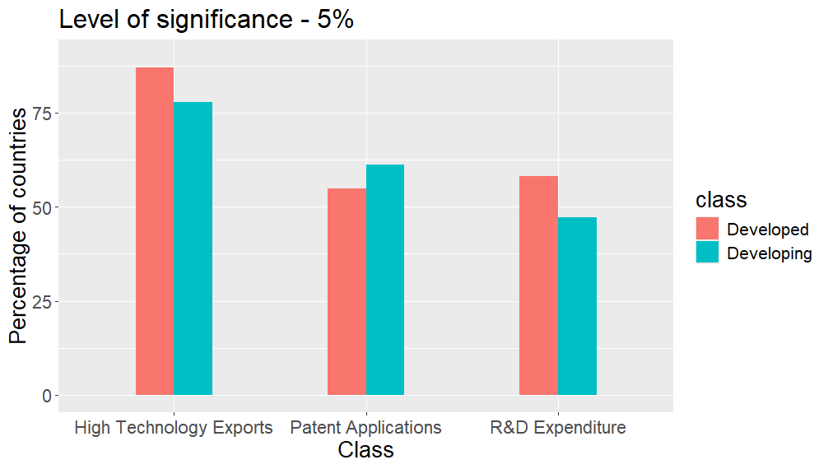
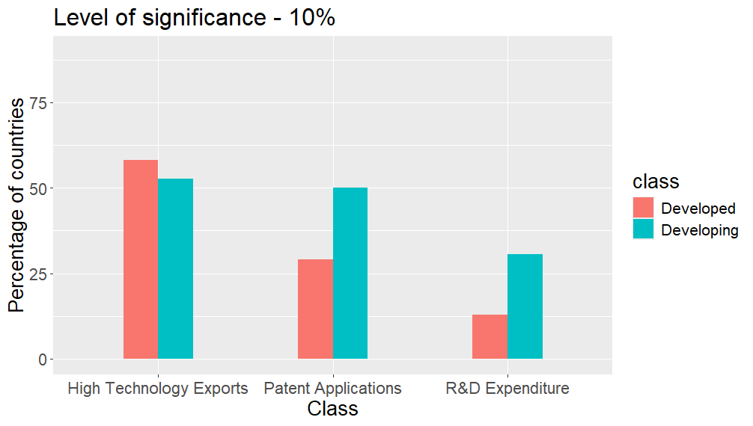
Run Test: Results
As expected, at higher significance level, we see lower count of random trends.
More developed nations seem to have weak trends in these parameters than developing countries.

Slide 13
Run Test: Results
High technology exports have remained relatively stable among all the nations, despite notable changes in R&D expenditure.
In terms of patent applications, developed countries have seen more changes than developing countries.

Slide 14


Mann-Kendall Test
Objective:
For the period of 2008-2021 we detect increasing, decreasing or stagnant trends.
Comparison of developed and developing countries.
Statistic:
Methodology (applied to each country for each parameter):
Following tests are used:
If the two-sided alternative is rejected, we give the verdict of “no.trend”.
Otherwise, we go for both one-sided test, and give verdict based on reasonable test.

Slide 15
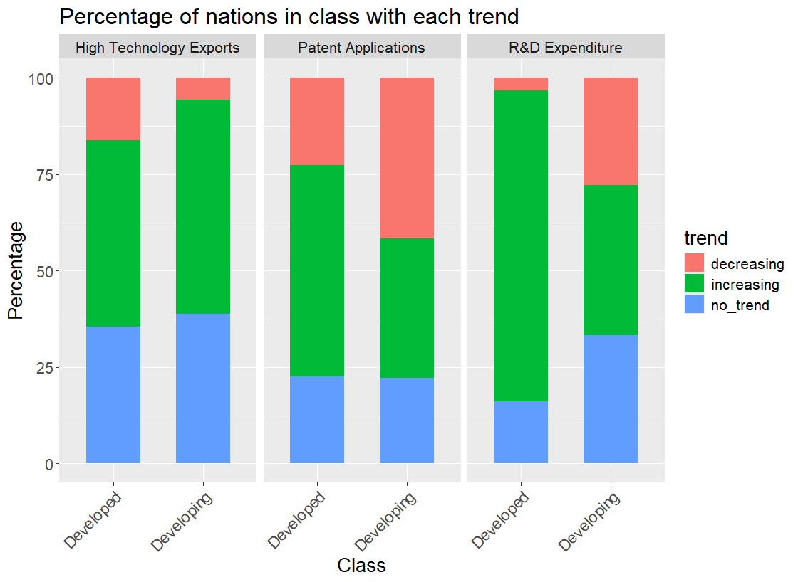
Mann-Kendall Test: Results
- High Technology Exports: Both developing and developed nations show similar patterns, indicating general slow growth over the years.
- Patent Applications: Developed countries have greater increasing trends, while it is mixed for developing countries. Better innovation systems may have contributed to this trend.

Slide 16
Mann-Kendall Test: Results
- R&D Expenditure: Developed nations have further increased their R&D expenditure, while developing countries have mixed trends indicating other priorities and challenges in maintaining funding for R&D
In general, developed countries have better outlook in terms of patent applications and R&D expenditure.

Slide 17
Two-sample Methods

Slide 18
Friedman Test
Objective:
Determine if there is a consistent trend or ranking among these indicators over time, indicating disparities in investment, innovation, or export.
Methodology (applied to each country for 3 parameter):
One-sided test
The null hypothesis is that the trends of the three time series are aligned
Analysis:
We use 0.01 level of significance.
For p-values < 0.01 we can say that the trends are not aligned
For p-values > 0.01 we will say that the trends are aligned
Result:
For all 73 countries, p-values were less than 0.01.

Slide 19
Spearman and Kendall Tests
Objective:
Identify significant correlations between the two countries on a specific indicator
Speculate underlying reasoning behind similarities or differences found using the tests
Identify significant correlations between two indicators of same countries
Methodology (applied to each pair of country for each indicator):
Null hypothesis : There is no correlation among the time series
Alternate: There is some correlation between the time series
Analysis:
We use 0.05 level of significance.
Null hypothesis is rejected if p-values are less than 0.05 for both the tests

Slide 20
Spearman and Kendall tests: Results
Comparison of indicators pairwise:
We counted number of rejections for each pair of indicators for all 73 countries
Reject count: 37 24 31
We can say that in general the indicators we have selected are not dependent on each other

Slide 21
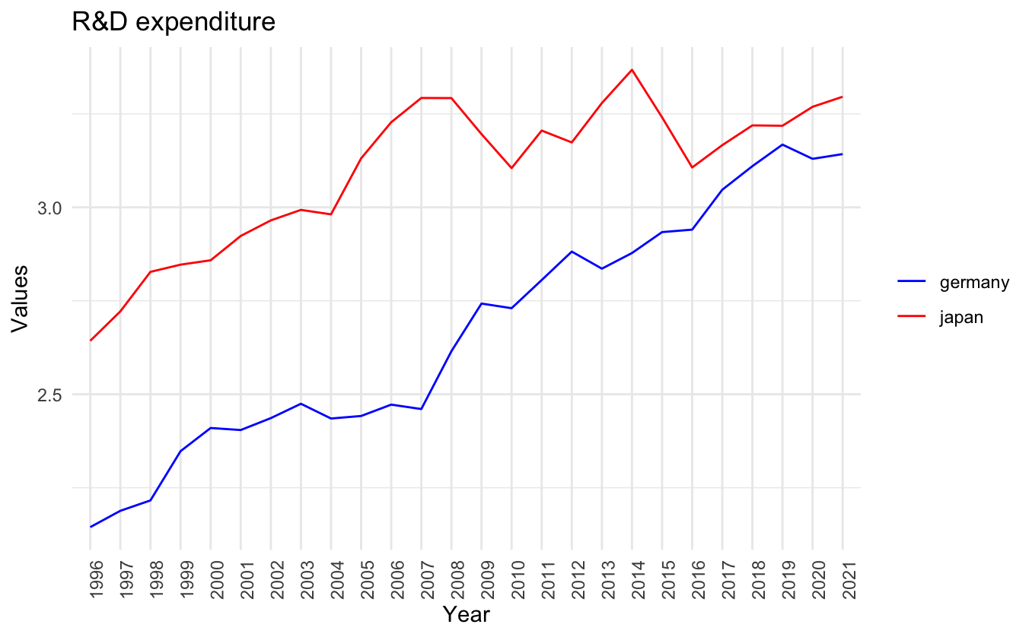
Spearman and Kendall tests: Results
Comparison of countries: Germany versus Japan in R&D expenditure
Spearman's rho: 0.7238 p-value: 4.698232e-05
Kendall's tau: 0.5754 p-value: 1.406392e-05
Since, Japan and Germany both are well
developed countries, their Spearman’s
Correlation coefficient is seemingly significant.

Slide 22
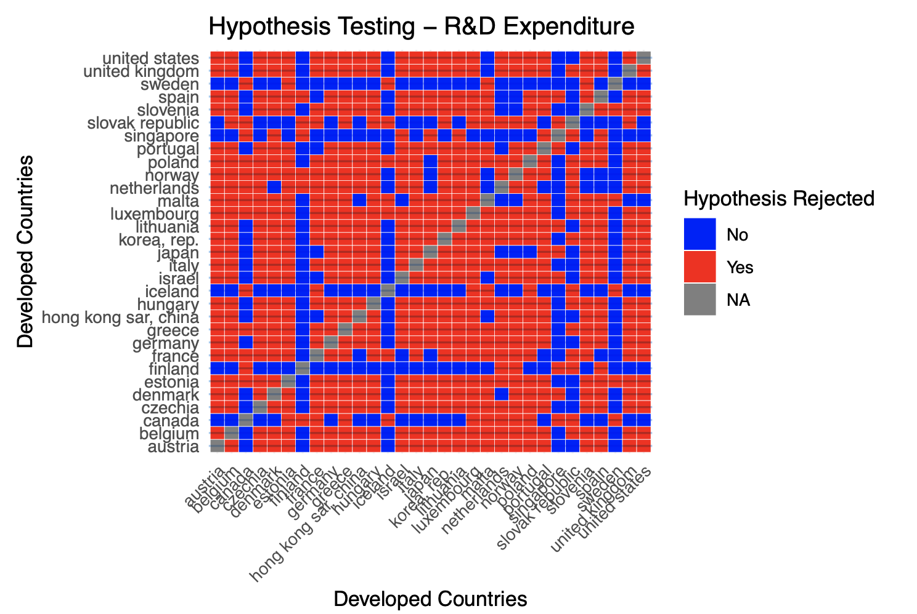
Spearman and Kendall tests: Results
Comparison of countries:
Heat map of developed vs developing countries comparison on R&D expenditure time series shows most of them are correlated. (Majority ‘Yes’)
This might be because developed countries compete more with each other in the sphere of R&D.

Slide 23
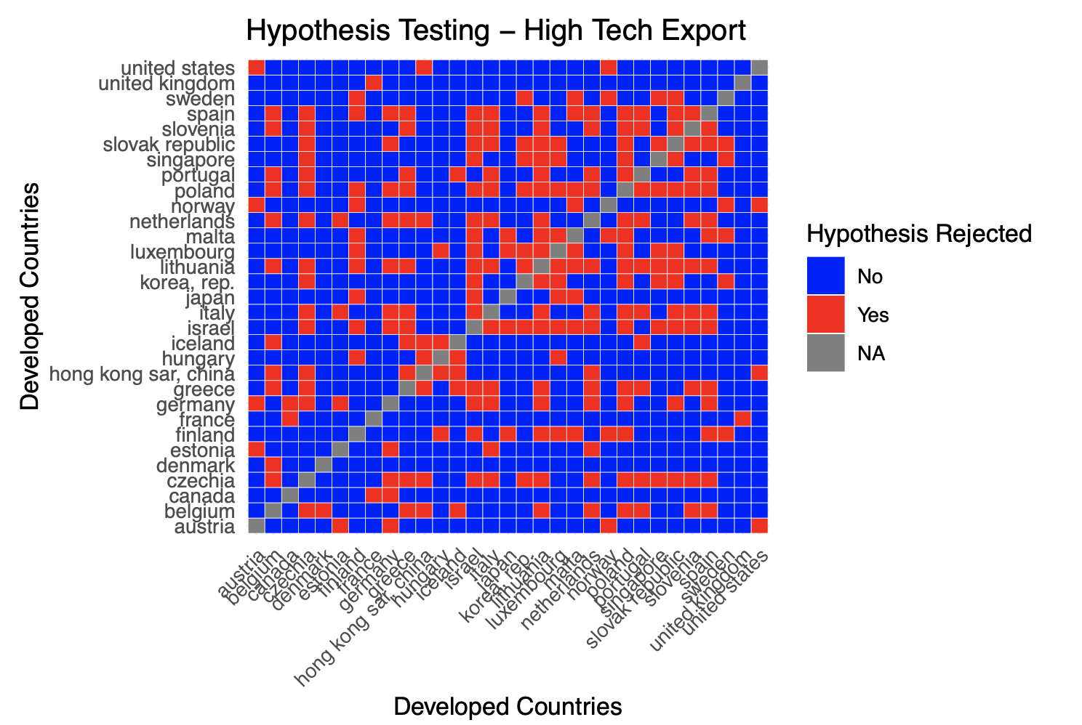
Spearman and Kendall tests: Results
Comparison of countries:
Heat map of developed vs developing countries comparison on High Tech export time series shows most of them are not correlated.(Majority ‘No’)
This is because the technological exports in the world are more or less polarised in the world. (Countries like USA & China)

Slide 24
Non-Parametric Time Series Forecasting
Challenges in Forecasting
Autoregressive Variable Selection
Smoothing Parameter Selection
Problem Statement: Considering a univariate time series, observed within, the series is modeled under the Markov assumption as:

Slide 25
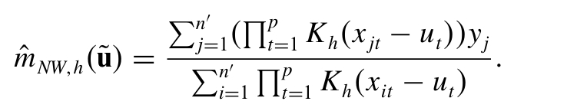
Nadaraya - Watson Regression Estimator
The Nadaraya-Watson estimator facilitates kernel-based nonparametric estimation of m. For any given point u, the estimator is computed as:
Where K_{h} is the univariate kernel.
Univariate bandwidth h is selected by cross validation method, that is used by inbuilt density function.

Slide 26
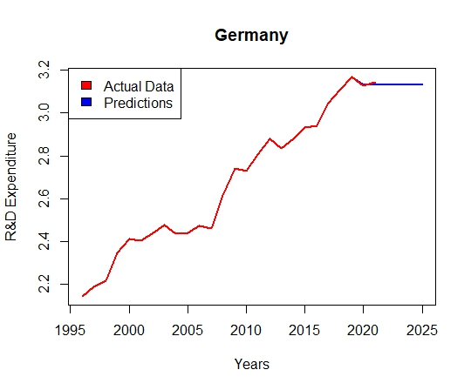
Forecasting Results
We have done predictions for all the three datasets, for some countries. Some of the results are as follows:

Slide 27
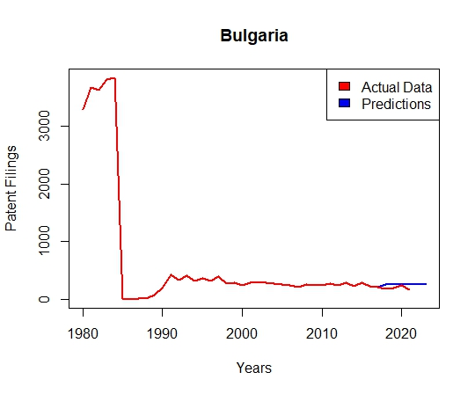
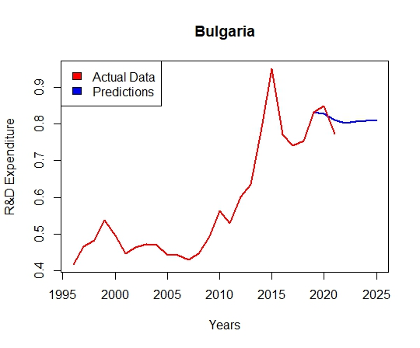

Slide 28
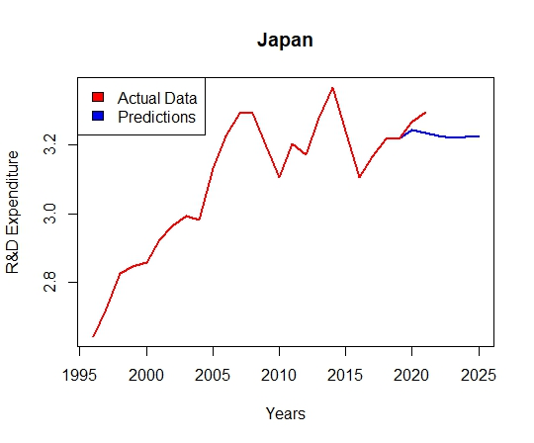
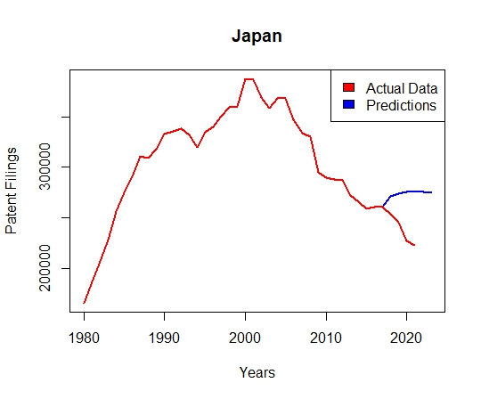
Not All Predictions are Good

Slide 29
References
Tjuan M. Vilar-Fernández & Ricardo Cao, Nonparametric Forecasting in Time Series - https://doi.org/10.1080/03610910601158377
Non - Parametric Statistical Inference by Jean D. Gibbons and S. Chakraborti

Slide 30
Thank You

